Slide 1

Healthcare Analytics for Doctor Visits
Ayush Madwaraj Shetty

Slide 2

PROBLEM STATEMENT
Healthcare organizations generate large amounts of patient and visit-related data.
Understanding patterns in doctor visits can help identify important factors associated with healthcare utilization.
This project analyzes a healthcare dataset containing 5,190 patient records.
The analysis focuses on:
  Number of doctor visits
  Gender and age
  Illness level
  Health condition
  Income and other healthcare-related variables
The objective is to identify meaningful patterns in doctor visit frequency using exploratory data analysis.

Slide 3
Project Description
This project performs exploratory data analysis (EDA) on healthcare data to understand patterns in doctor visits.
Dataset Overview
5,190 records
13 variables
No missing values were found.
Doctor visits range from 0 to 9.
The dataset includes demographic, health, illness, insurance and chronic-condition variables.
Analysis Performed
Statistical summary of the dataset
Distribution of doctor visits
Gender distribution
Age distribution
Comparison of doctor visits by gender
Relationship between illness level and average doctor visits
Key objective:
To use data-driven analysis to understand which patient characteristics are associated with differences in doctor visit frequency.

Slide 4

WHO ARE THE END USERS?
Healthcare Providers
Understand patient visit patterns
Identify groups with higher healthcare utilization
Hospital & Healthcare Administrators
Support resource and service planning
Analyze healthcare utilization trends
Healthcare Analysts / Data Scientists
Explore relationships between patient characteristics and visits
Develop further predictive analytics models
Public Health Researchers
Study healthcare utilization patterns across demographic and health-related factors

Slide 5

Technology Used
Programming Language
Python
Libraries
Pandas — data loading, cleaning and analysis
NumPy — numerical operations
Matplotlib — data visualization
Seaborn — statistical visualizations
Development Environment
Jupyter Notebook
Analysis Techniques
Descriptive statistics
Data quality / missing-value analysis
Histograms
Count plots
Box plots
Group-by analysis
Mean and median comparison

Slide 6
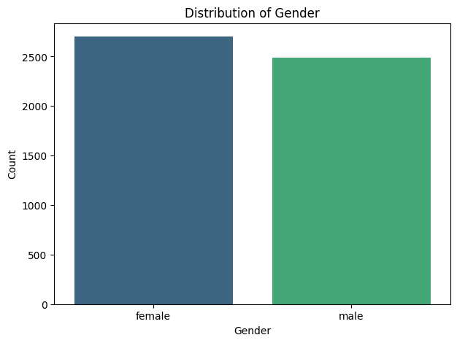
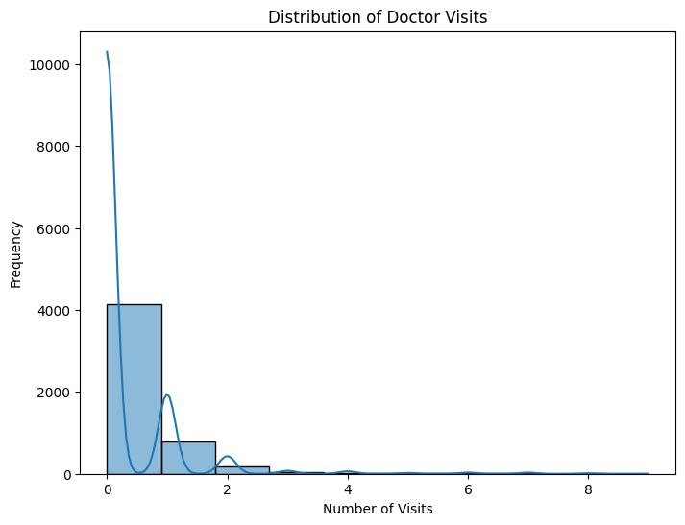
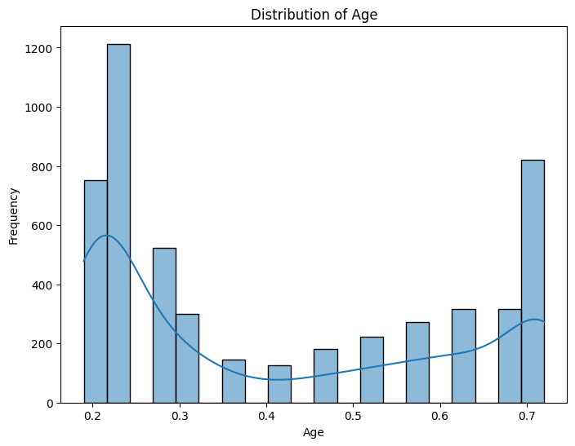
RESULTS
/tmp/ipykernel_587/3709590590.py:2: UserWarning: Ignoring `palette` because no `hue` variable has been assigned.
sns.histplot(df['age'], bins=20, kde=True, palette='plasma')
https://github.com/ayushshetty007/Healthcare-Analytics-for-Doctor-Visits

Slide 7

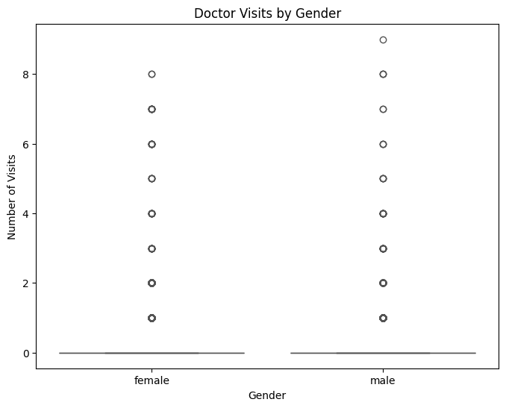

RESULTS
https://github.com/ayushshetty007/Healthcare-Analytics-for-Doctor-Visits

Slide 8
Thank you
.
.

